Slide 1
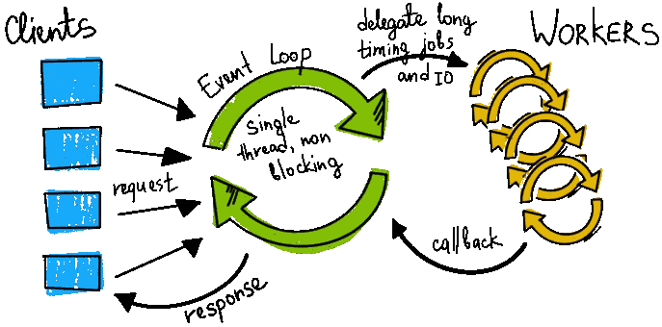
Shiny Deep Dive (01):
Non-Blocking Code
Khaled Al-Shamaa, Associate Scientist - Biometrics
2nd CGIAR BA Team Hackathon, 13 Nov 2024

Slide 2
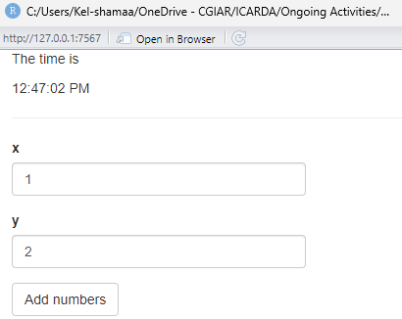
library(shiny)
library(shinybusy)
ui <- fluidPage(
p("The time is ", textOutput("current_time")),
hr(),
numericInput("x", "x", value = 1),
numericInput("y", "y", value = 2),
actionButton("btn", "Add numbers"),
textOutput("sum"),
textOutput("obj")
)
server <- function(input, output, session) {
output$current_time <- renderText({
invalidateLater(1000)
format(Sys.time(), "%H:%M:%S %p")
})
data <- reactiveVal(list(total = 0))
#...
}
shinyApp(ui, server)
Main Shiny App. Skeleton

Slide 3
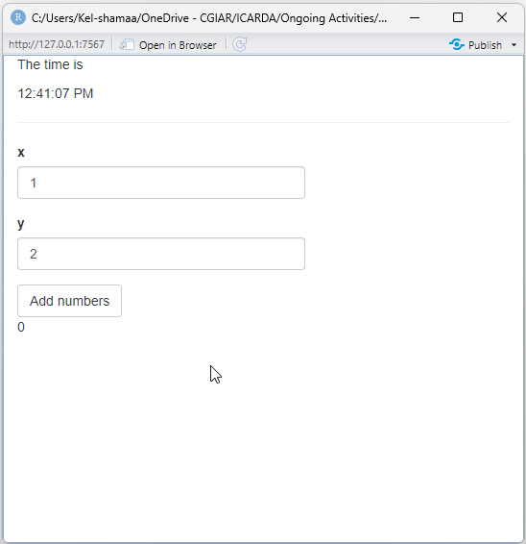

sum_values <- eventReactive(input$btn, {
shinybusy::show_modal_spinner()
# some long process
Sys.sleep(5)
z <- input$x + input$y
temp <- data()
temp$total <- temp$total + z
data(temp)
shinybusy::remove_modal_spinner()
return(z)
})
output$sum <- renderText({
results <- sum_values()
return(results)
})
output$obj <- renderText({
data()$total
})
Main Shiny App. Functionalities

Slide 4

Future & Promises R Packages
library(shiny)
library(shinybusy)
library(future)
library(promises)
future::plan(multisession)
ui <- fluidPage(
# No changes in the Shiny UI!
)
server <- function(input, output, session) {
output$current_time <- renderText({
invalidateLater(1000)
format(Sys.time(), "%H:%M:%S %p")
})
data <- reactiveVal(list(total = 0))
#...
output$obj <- renderText({
data()$total
})
}
shinyApp(ui, server)
future package provides unified parallel and distributed processing in R language by evaluating expressions asynchronously on multi-cores, multi-sessions/threads, or even compute clusters.
promises package provides abstractions for promise-based asynchronous programming, which is useful for allowing a single R process to orchestrate multiple tasks in the background while also attending to something else.

Slide 5
sum_values <- ExtendedTask$new(function(input, data) {
future_promise({
sum_values <- eventReactive(input$btn, {
shinybusy::show_modal_spinner()
# some long process
Sys.sleep(5)
z <- input$x + input$y
temp <- data()
temp$total <- temp$total + z
data(temp)
shinybusy::remove_modal_spinner()
return(z)
})
})
output$sum <- renderText({
results <- sum_values()
return(results)
})
Shiny ExtendedTask Wrapper
observeEvent(input$btn, {
shinybusy::show_modal_spinner()
ui_inputs <- shiny::reactiveValuesToList(input)
data_obj <- data()
sum_values$invoke(ui_inputs, data_obj)
})
ExtendedTask is a new shiny feature announced recently (on 20 March 2024) that provides an elegant wrapper for async programming technique to deliver non-blocking operations in the shiny framework. https://shiny.posit.co/r/articles/improve/nonblocking/

Slide 6
sum_values <- ExtendedTask$new(function(input, data) {
future_promise({
# some long process
Sys.sleep(5)
z <- input$x + input$y
data$total <- data$total + z
temp <- data()
temp$total <- temp$total + z
data(temp)
shinybusy::remove_modal_spinner()
return(list(output = z, obj = data))
return(z)
})
})
observeEvent(input$btn, {
shinybusy::show_modal_spinner()
ui_inputs <- shiny::reactiveValuesToList(input)
data_obj <- data()
sum_values$invoke(ui_inputs, data_obj)
})
output$sum <- renderText({
results <- sum_values()
results <- sum_values$result()
data(results$obj)
shinybusy::remove_modal_spinner()
return(results$output)
return(results)
})
Isolate Slow Code from Reactive Context

Slide 7
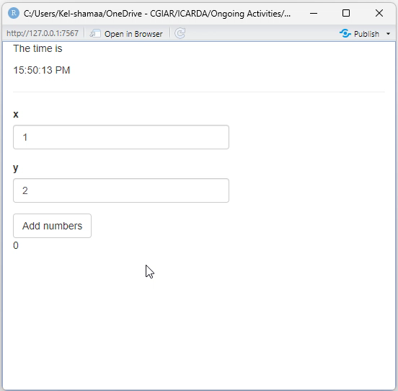
sum_values <- ExtendedTask$new(function(input, data) {
future_promise({
Sys.sleep(5)
z <- input$x + input$y
data$total <- data$total + z
return(list(output = z, obj = data))
})
})
observeEvent(input$btn, {
shinybusy::show_modal_spinner()
ui_inputs <- shiny::reactiveValuesToList(input)
data_obj <- data()
sum_values$invoke(ui_inputs, data_obj)
})
output$sum <- renderText({
results <- sum_values$result()
data(results$obj)
shinybusy::remove_modal_spinner()
return(results$output)
})
output$obj <- renderText({ data()$total })
Demo Non-Blocking Code

Slide 8
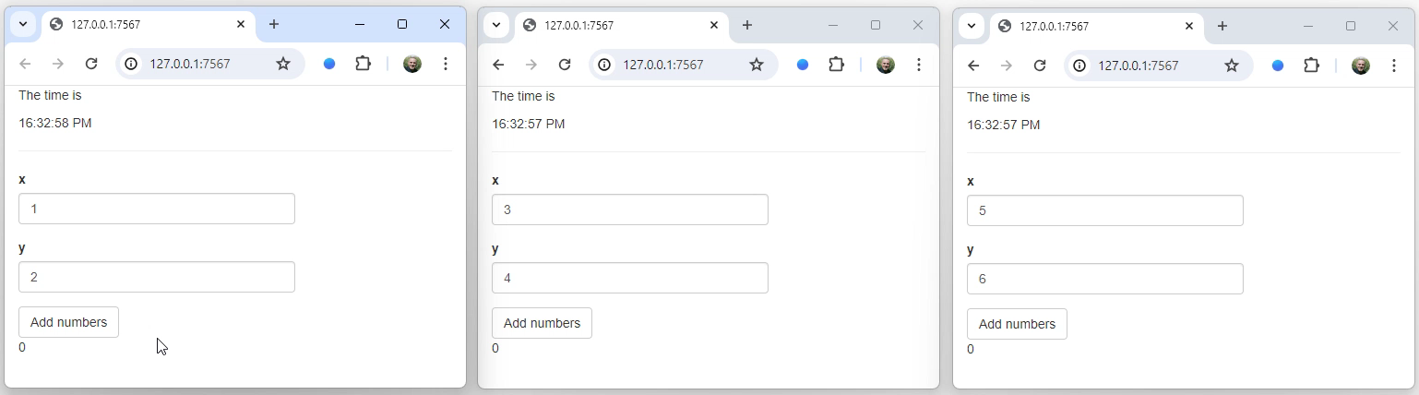
Multi-Users Scenario (Before)
If you have multiple users trying to access simultaneously, then one user’s long-running operation will block the other users’ apps from running as well. These other users will not even be aware that their slow performance is due to another user’s actions.

Slide 9

Multi-Users Scenario (After)
To achieve non-blocking behavior in Shiny applications, factor your slow code into an ExtendedTask object and wrap it with future_promise({...}). Take out any reactive reads and turn those into parameters. Then call its $invoke() method from a reactive effect and read its result() method from a render function or reactive expression.

Slide 10
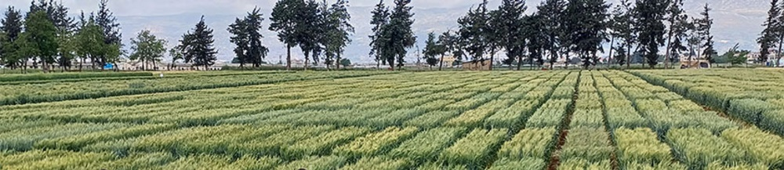

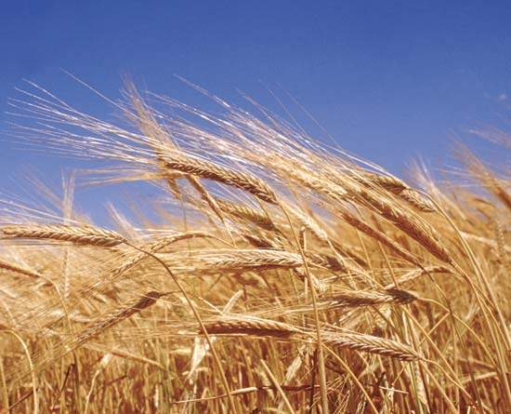
Thank You
Questions?

